Slide 1
TechWorkshop L300: AI Apps and Agents
Train the trainer
Notes:
Train-the-Trainer (TTT) Kickoff Script
Introduce Yourself
Thank Participants
State Objectives of the Session
Encourage Questions

Slide 2
Agenda
1
Workshop general information
Audience, abstract, objectives and agenda
2
Prepare for the workshop
Roles and responsibilities, next deliveries, configuration and navigating Teams
3
Proven Practices
Proven practices for Coaches
4
Activity and Lab information
Activity overview and lab walkthrough
5
Friendly reminder
Additional clarification
6
Q&A
TTT additional clarification
Notes:
MCAPS are providing the course content, Coaches provide their personal experience related to the content. In the TTT and Pre-call -LID explains the course flow and key points -Experienced coaches explain delivery proven practices -All coaches discuss how to bring in their personal experience Being an internal coach is a “firm commitment” -Can’t just cancel at the last minute -Can’t take a customer call in the middle of the class

Slide 3
Workshop general information

Slide 4










Target audience
Primary audience:
CAIP Solution Engineers
CAIP Cloud Solution Architects
CAIP Global Black Belts
Notes:
KEY POINTS:
Identify the key target audience for the workshop.
Audience Characteristics
Technical Expertise:
Participants are highly technical and knowledgeable in Azure AI solutions, requiring content to be precise and in-depth.

Slide 5
Workshop abstract
In this virtual instructor-led 300-level workshop, you’ll develop the skills to design and deploy agentic AI solutions that enhance customer engagement and streamline development workflows. Using a retail scenario, you’ll explore building impactful, scalable and responsible agentic AI Solutions for the customers, along with orchestration across multiple agents using Agentic AI frameworks, Models, tools and integration technologies (MCP, A2A). Through hands-on labs and discussions, you’ll gain practical experience with Azure AI Foundry and Azure data, apps, and integration services, along with Microsoft Copilot Studio and GitHub, to build secure, scalable, and impactful AI applications.
Notes:
Workshop Overview (Verbal Introduction by Lead Coach):
Start the session by introducing the workshop as an advanced, hands-on 300-level learning experience designed for Azure professionals.
Emphasize the real-world applicability of the skills being developed, highlighting that the focus will be on agentic AI solutions.
Mention that participants will gain confidence in guiding clients through the hero products by practicing proven strategies and tools.

Slide 6
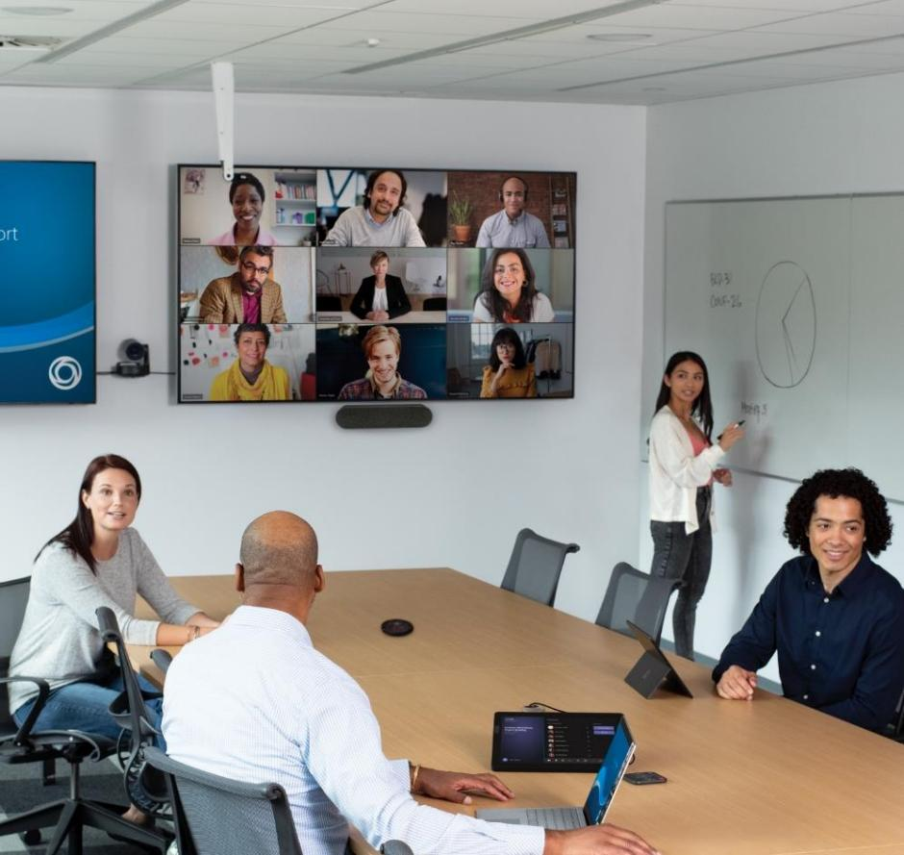
Learning objectives
At the end of this workshop, participants will be able to:
Envision a technical architecture for agentic AI solutions based on customer needs and AI practices
Develop secure and scalable AI systems that comply with responsible AI principles and protect sensitive business data.
Apply agentic DevOps practices to accelerate software development and deployment using GitHub Copilot, GitHub Actions, and Azure CI/CD pipelines.
Design agentic AI solutions (single agent, multi agent) using Agentic AI frameworks, Models, tools and integration technologies
Notes:
Speaker notes:
Review the learning objects with the trainers.
Learning Objectives Delivery (Lead Coach):
Introduce the Objectives:
Use a visual aid (slide deck or whiteboard) to present the workshop's objectives.
Verbally emphasize that the session focuses on both technical skills and strategic knowledge.
Connect each learning objective to real-world scenarios participants are likely to encounter.
Break Down Objectives:
Objective 1: Envision a technical architecture for agentic AI solutions based on customer needs and AI practices
Briefly discuss the importance of technical envisioning with customers and whiteboarding architecture.
Link this objective to the whiteboard session.
Objective 2: Develop secure and scalable AI systems that comply with responsible AI principles and protect sensitive business data.
Highlight the business relevance of secure and scalable AI systems in driving customer adoption and success.
Objective 3: Apply agentic DevOps practices to accelerate software development and deployment using GitHub Copilot, GitHub Actions, and Azure CI/CD pipelines.
Connect to practical applications, ensuring the discussion is customer-focused and outcome-driven.
Objective 4: Design agentic AI solutions (single agent, multi agent) using Agentic AI frameworks, Models, tools and integration technologies
Detail how participants will practice this in the lab exercises.
Student Interaction:
Invite participants to share their current challenges or past experiences with similar workloads to establish a collaborative atmosphere.

Slide 7
Workshop agenda day one
Start | Duration | Session | Channel
09:00 | 10 | Welcome and course overview | General
09:10 | 60 | Overview of agentic AI, use cases, Innovate with Azure AI Apps and Agents solution play, and agentic AI solution architecture | General
10:10 | 30 | Intro to case study, envisioning whiteboard, and lab exercises one and two | General
10:40 | 60 | Technical envisioning and architecture whiteboard session | Team
11:40 | 30 | Break
12:10 | 60 | Exercise one: Deploy application resources | Team
13:10 | 60 | Exercise two: Implement a multimodal AI shopping assistant | Team
14:10 | 10 | Debrief on exercises one and two | Team
14:20 | 10 | Day one wrap-up | General
Notes:
Speaker notes:
General timing considerations:
Lecture content may be a review for many students – depending on the audience you can skip or brush over content to save time – the deck can be a reference for students.
Team exercises are between 40 and 60 minutes long.
There is one 30-minute break on the first day
Additionally, consider the following recommendations:
The exercise debriefs and discussions are 10 minutes minutes each. It’s recommended that students take notes during the labs, so the debrief sessions are productive and enriching for all the team.

Slide 8
Workshop agenda day two
Start | Duration | Session | Channel
09:00 | 10 | Day two welcome and day one review | General
09:10 | 30 | Challenges and multi-agent orchestration | General
09:40 | 10 | Intro to lab exercises three through six | General
09:50 | 40 | Exercise three: Extend the shopping assistant using the A2A protocol | Team
10:30 | 60 | Exercise four: Observe model utilization in AI Foundry | Team
11:30 | 10 | Debrief on exercises three and four | Team
11:40 | 45 | Break
12:25 | 60 | Exercise five: Agentic DevOps | Team
13:25 | 40 | Exercise six: AI-enhanced red teaming | Team
14:05 | 10 | Debrief on exercises five and six | Team
14:15 | 15 | Course wrap-up | General
Notes:
Coach Guidance for Day 2 Agenda
Walkthrough the Agenda for Day 2
Stick to scheduled break times and announce them clearly in advance to maintain focus and energy levels.
Managing Overruns:
Monitor the schedule closely and make adjustments if needed:
Shorten discussions to prioritize completing the exercises.
Avoid skipping breaks, as they help maintain engagement.
Wrap up on time to respect participants’ schedules and avoid conflicts with follow-up meetings.
End of Day Wrap-Up:
Summarize key accomplishments from Day 2, focusing on the practical skills gained.
Provide guidance on next steps, including follow-up resources or optional Q&A sessions for any remaining questions.

Slide 9
Prepare for the workshop

Slide 10
Coach role
Lead Coach and Coaches
Review the Coach onboarding guide to prepare your responsibilities during the delivery.
The Lead Coach delivers the Welcome, lectures, and wrap-up in the General channel at the start and close each day.
Coaches provide feedback in the chat, overview, oversight, and course corrections for the exercise, and remain with their teams to help learners who are stuck or have questions.
Coaches support the Team with any issues (content, technical, or otherwise).
Each coach stays with their assigned Team channel.
Notes:
KEY POINTS:
Review and differentiate the roles and responsibilities of Coaches.

Slide 11
Coach responsibilities
Lead Coach and Coaches
Being a coach is a firm commitment to actively participate throughout the entire course.
Last minute cancellations should be avoided.
Customer calls should not interrupt class sessions.
The PowerPoint outlines the course structure and key concepts
Share your personal experiences and make the content relatable.
What strategies have been effective with your customers?
Notes:
KEY POINTS:
Review and differentiate the roles and responsibilities of Coaches.
We will have somebody we try to have a backup coach in as many cases as possible who is who's there in case somebody gets sick or some emergency happens.

Slide 12
FY25 workshop deliveries
Class info | SOID | Start | End | Lead Coach | Coach | Coach
America- LA | 2400240 | 10/28/25 | 10/29/25 | Kevin Feasel feaselkl@solliance.net | Omar Villarreal Omar.Villarreal@microsoft.com | TBD
Europe - London | 2400241 | 11/5/25 | 11/6/25 | Anupama Natarajan anupama.natarajan@solliance.net | TBD | TBD
Asia - Singapore | 2400242 | 11/12/25 | 11/13/25 | Raju Rh raju.rh-c@skillable.com | Ramesh Maganti rmaganti@microsoft.com | TBD

Slide 13
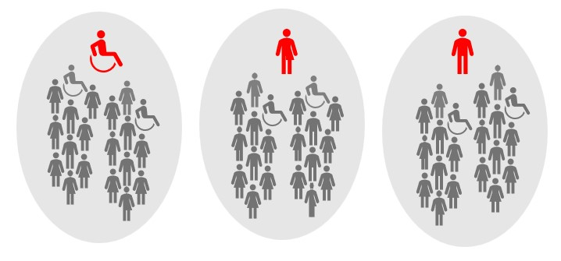

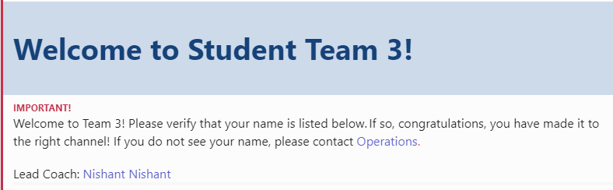
Team activities configuration
Each team is assigned a Coach and a Team channel in Teams.
1
2
3
4
Coach
Participant
Each workshop includes pre-assigned teams with a maximum of 20 students per team. Average class size is 60, but can be extended to 120.
Notes:
Coach Present the breakout room and add the correct ratio. Example: we have 1 Coach per 15 students or 1/20.

Slide 14
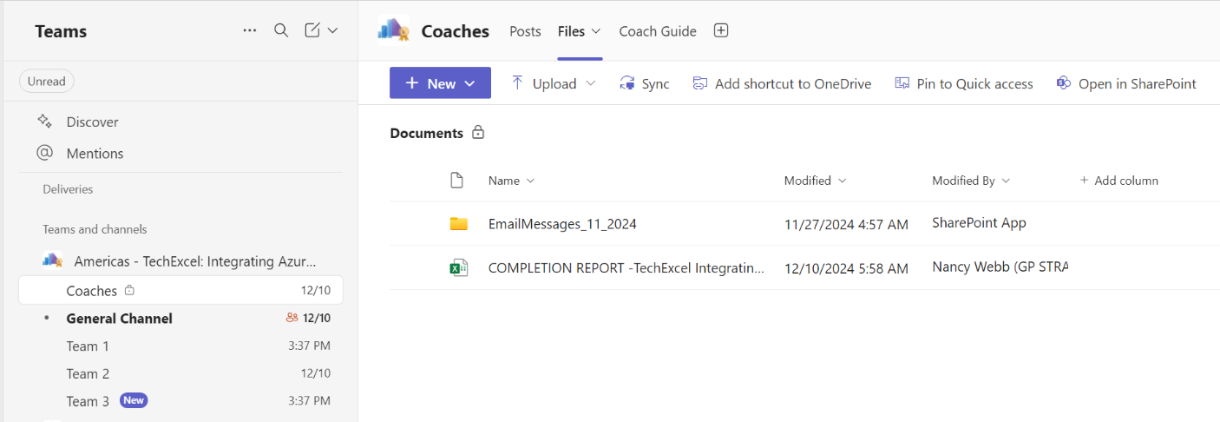
Navigating the Teams instance
1
4
5
Find your workshop in Teams.
Select the Coach channel then select Coach guide to download latest documents.
The Lead Coach uses the Presentations downloaded for the Welcome and Wrap up.
6
Coaches will fill the Completion Report with the performance information of all students.
2
The moderator will start the Coaches pre-workshop call in the Coaches channel.
3
The workshop will start in the General channel.
Notes:
KEY POINTS:
Demonstrate the location of the following items:
Location of the Team channels
Where to find the lab link
How to rejoin the General channel call
How to find the assigned teams
If students encounter any technical problems at the beginning of each workshop, they should contact the Moderator or the Ops contact listed in the Posts tab.

Slide 15
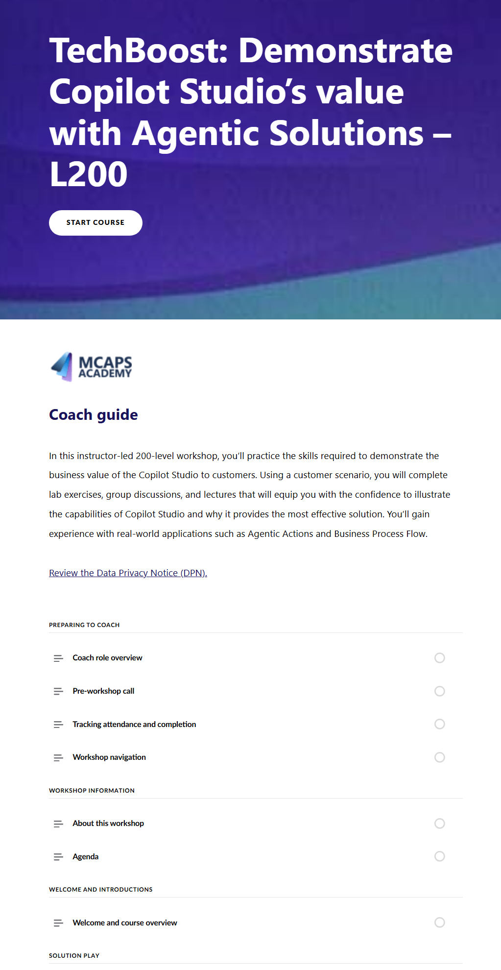
Navigating the guides
TechWorkshop L300: AI Apps and Agents
1
Select Start course to review the workshop content.
2
Module name.
3
Unit content.
Notes:
KEY POINTS:
Review how to navigate the guides.

Slide 16
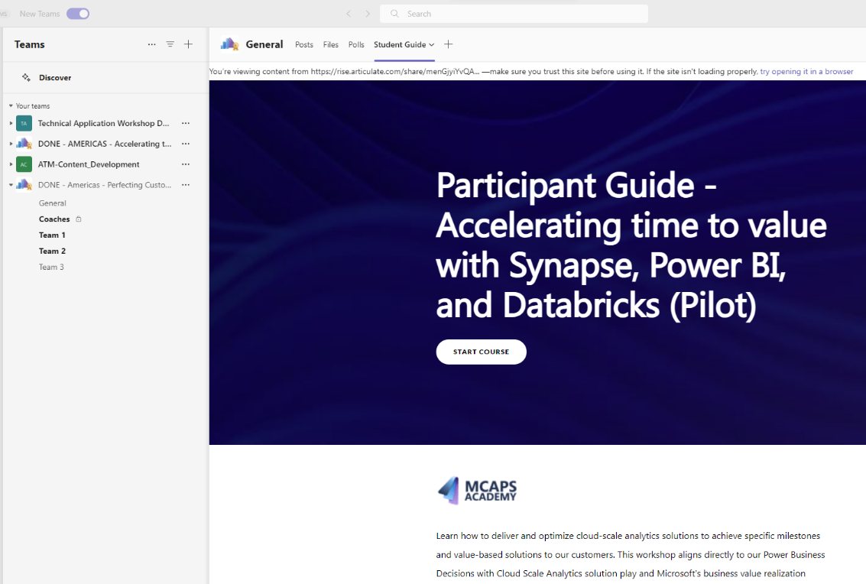
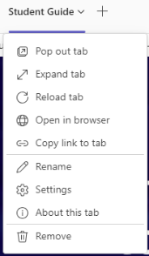
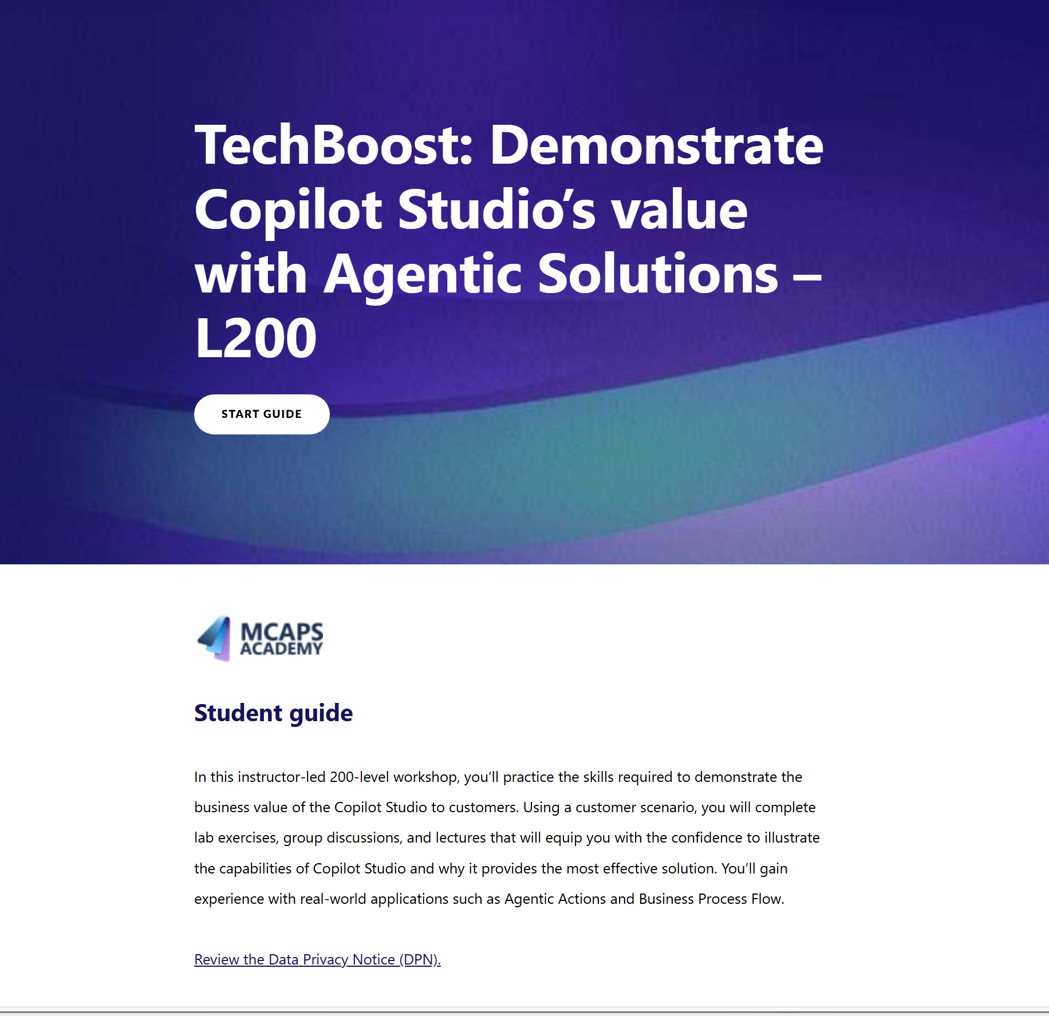
Student Guide
1
Open the guide in the Teams Window.
2
Open the guide in another tab or in a browser.
Coach Guide
Student Guide
Notes:
KEY POINTS:
Walk through the different parts of the guide.
The course guide contains details on every activity in the workshop.
There are sections for Coaches with instructions, timing, and guidance for all activities.
The Student Guide contains the Introduction, Lab and Teams navigation tips, Workshop content, Workshop activities, and Resources.

Slide 17
Coach and student lab access
TTT
Explore the labs and get ready to work with students!
Access the GitHub repository at https://github.com/microsoft/TechWorkshop-L300-AI-Apps-and-agents and walk through the lab exercises at least once prior to the workshop.
During the workshop, you and the students will access the lab exercises through GitHub I/O pages, https://aka.ms/AIDF_S9302714_GHIO. The I/O pages contain a link back to the GitHub repository.
The GitHub repository is public.

Slide 18
Proven practices for Coaches
Additional information

Slide 19
Recommendations
Before delivery day
Verify the date, start time, and region of the workshop.
Read carefully the Coach Onboarding guide to prepare for the delivery.
Review students’ prework information.
Go over the Coach Guide and the workshop deck including the speaker notes.
Spend time understanding the discussion questions, answers, and their importance.
Review the customer case study to be able to share highlights.
Run the labs, review the exercises and labs steps. Report any issues if needed.
Notes:
Coach

Slide 20

Tips and tricks
Have the presentation deck open in desktop app mode.
Stay on camera and encourage others to do the same - Unless there are bandwidth concerns..
Send a welcome note in your Team channel.
Use questions from your team to start discussions about how the rest of the team handles issues.
Select the link provided by the moderator to join your team call.
Be sure to use the Coaches channel for questions and communication!
Notes:
KEY POINTS:
Review the proven practices for delivering a workshop online in Teams.

Slide 21
Proven practices
Foster Engagement
Encourage participants to share their own experience.
Highlight how lab exercises or activities connect to real-world scenarios.
Be Intentional
Adapt to varying levels of participant understanding.
Recognize that not every situation is covered in the course.
Maximize Value
Prioritize activities and content that provide the most impact.
Emphasize actionable takeaways that participants can apply immediately.
Notes:
Foster Engagement
Share personal experiences and encourage others to share.
Address challenges or questions together.
Show how lab exercises relate to real-world scenarios.
Provide expert insights or feedback in real time.
Be Intentional
Pace the session carefully—avoid rushing or dragging.
Adapt to different participant understanding levels.
Understand that not all situations are covered in the course.
Keep discussions and activities clear and purposeful.
Maximize Value
Prioritize high-impact activities and content.
Ensure every moment contributes to learning or growth.
Focus on actionable takeaways for immediate use.

Slide 22
Activity information

Slide 23
Day one activities
Day one lecture
Case study/technical envisioning/lab intro
Workshop path
Technical envisioning whiteboard session/Lab exercises one and two + discussions
Wrap-up
Notes:
3-hours delivery

Slide 24
Day one lecture – 60 mins
Overview of agentic AI, use cases, Innovate with Azure AI Apps and Agents solution play, and agentic AI solution architecture
This lecture provides the students with an overview to Agentic AI and its use cases as well as the Innovate with Azure AI Apps and Agents solution play. This will set the stage for the discussions, group activities, and lab exercises for this day.
You should make this as interactive as possible bringing in your own expertise and asking students to do the same. There are many opportunities for discussion throughout the lecture in the notes.
The lecture covers the following topics:
Agentic AI overview (10 slides)
Customer use cases (7 slides, disc)
Solution play (8 slides)
Architecture of agentic AI solutions (11 slides, disc)
Notes:
KEY POINTS:
Lecture
The Lead Coach will present the Day 1 lecture.
You can present the flow of the lecture if needed.

Slide 25

Intro to case study, envisioning whiteboard, and lab exercises one and two – 30 mins
Case study: Zava is a well-known online retailer specializing in home goods such as appliances, power tools, and paint.
The case study covers the following topics:
Overview
Current state
Customer needs
Customer objections
Envisioning whiteboard: There are two parts to this lesson.
Analyze Zava to prepare to whiteboard the solution architecture.
Whiteboard the solution architecture that best meets Zava’s needs.
For these, set the purposes and the expected outcomes.
Day one lab exercises: There are two lab exercises on day one.
Exercise one: Deploy application resources
Exercise two: Implement a multimodal AI shopping assistant
For these, set expectations by covering the scenario, the tasks, and the duration.

Slide 26


Technical envisioning and architecture whiteboard session – 60 mins
Analyze Zava’s needs (25 mins)
In teams, students will analyze Zava to identify the priority strategic, business, and technical requirements to address in the solution to prepare for the architecture design portion.
Students will first introduce themselves and then as a team begin the analysis using the following resources to assist:
AI Discovery Questionnaire
Decision Tree for Databases, App Hosting, and Integration
Use Case Prioritization Matrix
Architecture design
Using a whiteboard template, teams will draft a Microsoft Azure AI agentic architecture design that meets Zava’s requirements.
They’ll:
Identify key services.
Explain which components, connections, and dependencies you should include and why:
Discuss how to explain the architecture to the customer.

Slide 27


Day one lab exercises
Exercise one: Deploy application resources – 60 mins
In this first exercise, we’ll set the stage for Zava by deploying out resources needed for the proof of concept, as well as ensuring that we have the client tools necessary to run through the remaining exercises.
Exercise two: Implement a multimodal AI shopping assistant – 60 mins
In this exercise, we’ll build a series of agents and test them locally before deploying the application code to Azure.
Debrief on exercises one and two – 10 mins
After the exercises, hold a discussion on both labs to help connect the exercises to real world and share proven practices.

Slide 28
Day two activities
Day one recap/day two overview
Day two lecture and intro to day two labs
Workshop path
Lab exercises three through six + discussions
Wrap-up
Notes:
3-hours delivery

Slide 29
Day two lecture – 30 mins
Challenges and multi-agent orchestration
This lecture is an extension to day one’s lecture. It provides the students with an overview of the challenges organizations face when implementing agentic AI solutions as well as what multi-agent orchestration involves. This will set the stage for the lab exercises and discussion for this day.
You should make this as interactive as possible bringing in your own expertise and asking students to do the same. There are many opportunities for discussion throughout the lecture in the notes.
The lecture covers the following topics:
Challenges in development with AI agents (6 slides)
Multi-agent orchestration (6 slides)
Notes:
KEY POINTS:
Lecture
The Lead Coach will present the Day 2 lecture.
You can present the flow of the lecture if needed.

Slide 30
Intro to lab exercises three through six – 10 mins
There are four lab exercises on day two.
Exercise three: Extend the shopping assistant using the A2A protocol
Exercise four: Observe model utilization in AI Foundry
Exercise five: Agentic DevOps
Exercise six: AI-enhanced red teaming
For these, set expectations by covering the scenario, the tasks, and the duration for each.

Slide 31
Day two lab exercises – pre-break
Exercise three: Extend the shopping assistant using the A2A protocol – 40 mins
In this exercise, we’ll use the Agent2Agent (A2A) Protocol to enable communication between multiple AI agents. This will allow us to create a more sophisticated shopping assistant that can leverage the strengths of different AI models and services.
Exercise four: Observe model utilization in AI Foundry – 60 mins
In this exercise, you’ll learn how to use the observability features in Azure AI Foundry to monitor and trace the performance of your deployed AI models. You’ll explore the Foundry Application analytics dashboard, trace model requests and responses, and analyze telemetry data using Azure Application Insights.
Debrief on exercises three and four – 10 mins
After the exercises, hold a discussion on both labs to help connect the exercises to real world and share proven practices.

Slide 32
Day two lab exercises – post-break
Exercise five: Agentic DevOps – 60 mins
In this exercise, you’ll learn how to use GitHub Copilot to generate GitHub Actions workflows that automate the deployment of an Azure Container Registry and Azure AI Foundry agents. By the end of this exercise, you’ll have a solid understanding of how to use GitHub Actions to streamline your DevOps processes and improve the efficiency of your development workflow.
Exercise six: AI-enhanced red teaming – 40 mins
In this exercise, we’ll review the Azure AI Red Teaming agent and apply it to the Zava shopping assistant application.
Debrief on exercises five and six – 10 mins
After the exercises, hold a discussion on both labs to help connect the exercises to real world and share proven practices.

Slide 33
Lab information
Access and outline

Slide 34
Lab outline
Labs are completed by each team in their Team channel, with the Coach providing instructions, keeping time, and answering questions. The labs are accessed online and can also be accessed through GitHub.
DAY ONE
DAY TWO
Exercise one
Deploy application resources
Exercise two
Implement a multimodal AI shopping assistant
Exercise three
Extend the shopping assistant using the A2A protocol
Exercise four
Observe model utilization in AI Foundry
Exercise five
Agentic DevOps
Exercise six
AI-enhanced red teaming
Notes:
Coach Review with students the exercises to be completed on day one and two.
In Day 1 we will do exercise one:
In Day 2 we will do exercise two:
and exercise three:
Notes:
Exercise files contained in GitHub link.
The initial exercise sets the stage for the other subsequent labs.
It is recommended that students pay close attention to the instructions listed in detail in GitHub.​

Slide 35
Lab structure
Intro: Objectives, instructions. (5 minutes)
Experiential labs: Two exercises on the first day and four on the second day for a total of 5 hr 20 min. Students will practice using the technology in the context of the customer scenario.
Team lab exercises debrief: 10 min per pair of lab exercises. Debrief labs, discuss among students' lessons learned, and share real-life experiences.
Notes:
KEY POINTS:

Slide 36
Coach and student lab access
Explore the labs and get ready to work with students!
Access the GitHub repository at https://github.com/microsoft/TechWorkshop-L300-AI-Apps-and-agents and walk through the lab exercises at least once prior to the workshop.
Students will access the lab exercises through GitHub I/O pages, https://aka.ms/AIDF_S9302714_GHIO. The I/O pages contain a link back to the GitHub repository.
The GitHub repository is public.
Notes:
Now we begin the hands-on portion of this workshop.
Coach:
Access the GitHub repository at <repository link> and walk through the lab exercises at least once prior to the workshop.
Students will access the lab exercises through GitHub I/O pages, <aka link for I/O pages>. The I/O pages contain a link back to the GitHub repository.
The GitHub repository is public.

Slide 37
Lab walkthrough
We'll now do a live walkthrough of the labs you'll use in the workshop.
Notes:
Speaker notes:
Remind students about the tasks that will be completed in this exercise and the estimated time for exercise 1.
Tasks
In this lab you'll:
Estimated Time: 40 minutes
:
In this exercise, you'll
Learning objectives
After completing this lab, you'll be able to:

Slide 38
Friendly reminder
Additional information

Slide 39
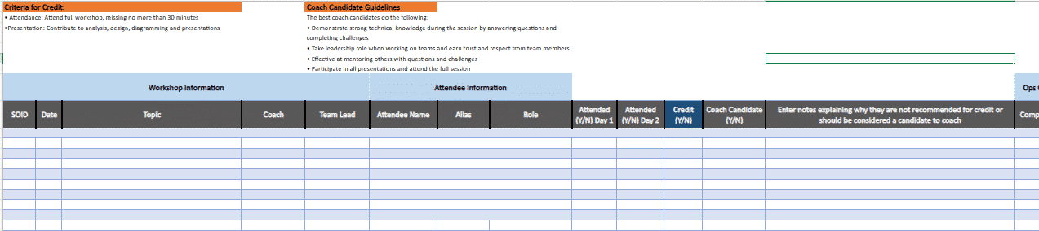
Tracking attendance and completions
As a Coach, you must complete the report on students' participation during the workshop.
In order to receive credit, students must fulfill the following requirements:
Attendance: Student missed no more than 30 minutes of the workshop. If a student missed more than 30 minutes, mark "N" in both "Criteria for Credit Met" and "Credit" columns.
Student contributed to discussions and exercises.
Notes:
KEY POINTS:
Review the tracking attendance and completion report.

Slide 40
Course evaluation
Remember to point students to complete the evaluation survey at https://aka.ms/classeval.
Lastly, give a reminder that if any of the students is interested in becoming a Coach, they can complete the Technical Mastery Workshops - Coach Recruiting form.

Slide 41
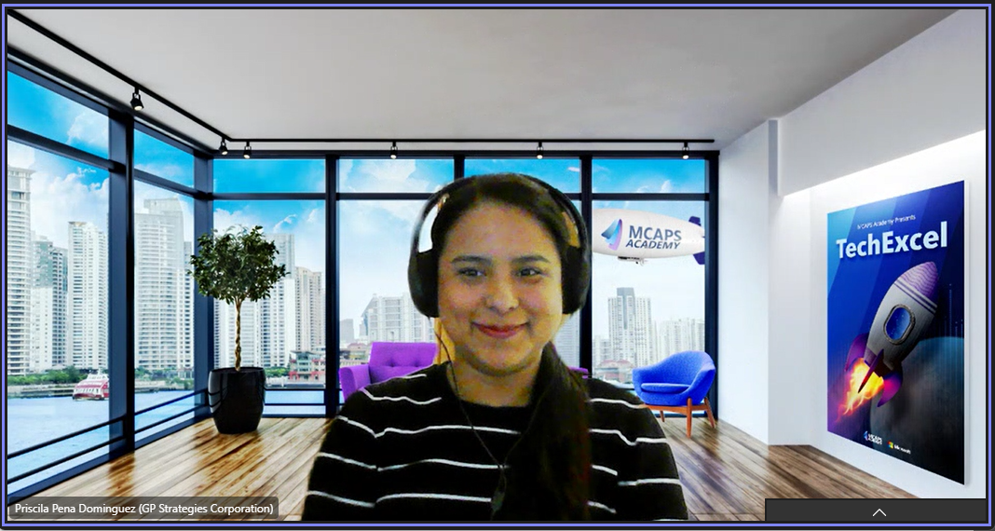
Remember!
1. Open the MCAPS background.
2. Download, save, and use as your background.
Notes:
KEY POINTS:
Remind Coaches about how to use the MCAPS background.
TechBoost: https://microsoft.sharepoint.com/:i:/r/teams/CommunicationsonAcademy/Shared%20Documents/Visual%20Identity/Collateral/Technical_Mastery/Teams_Backgrounds/TechMastery_Boost_Bgd.png?csf=1&web=1&e=pL9bOU
TechExcel:
https://microsoft.sharepoint.com/:i:/r/teams/CommunicationsonAcademy/Shared%20Documents/Visual%20Identity/Collateral/Technical_Mastery/Teams_Backgrounds/TechMastery_Excel_Bgd.png?csf=1&web=1&e=cGumec

Slide 42
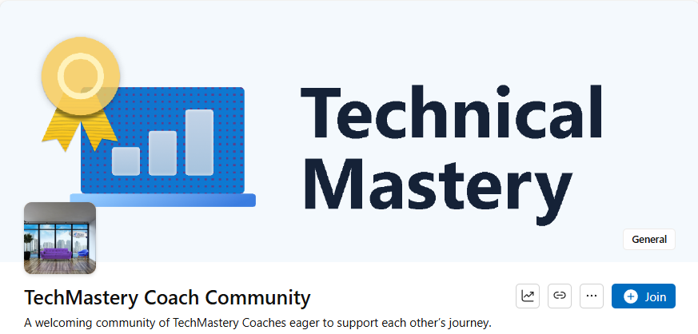
Coach community
Connect, communicate, and share ideas.
Access the latest Coach resources, tips, and proven practices.
Seek advice, share success stories, or brainstorm strategies.
Engage with your community: Introduce yourself and connect with others!
Viva Engage - TechMastery Coach Community
A collaborative space for internal Coaches.
Together, we drive learning, leadership, and growth.
Notes:
-The Coach Community is a space where internal coaches can collaborate, share coaching experiences, and learn from one another.
- Also can find helpful resources and the latest coaching tips to guide coaches through TechMastery workshops.
- Remember to check [aka.ms/techworkshop](https://aka.ms/techworkshop) for a full list of upcoming workshops and to stay updated on what’s next.

Slide 43
Questions?
TTT additional clarification

Slide 44
Thank you

